Slide 1
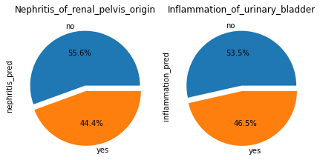
Acute Inflammations project
My goal in this project is to study the urology dataset to later prepare an expert system algorithm that will hypothetically diagnose two urological diseases: cystitis and nephrolithiasis. Where the user is asked about certain symptoms and predicts the disease correctly. For the success of my study of the data, I visualized the data and studied the relationships between the symptoms of the disease that the patient enters and the disease, and the extent to which symptoms affect the identification of the disease. Then represent it with a drawing in some way so that it can be easily described to the groups concerned.
At the level of the data monitored for us, the percentages of infected people for each disease are fairly close, As the percentage of people with Inflammation_of_urinary_bladder disease reached 46.5% and the percentage of people with disease Nephritis_of_renal_pelvis_origin reached 44.4% Accordingly, the percentage of people with Inflammation_of_urinary_bladder infection is more than people with Nephritis_of_renal_pelvis_origin

Slide 2
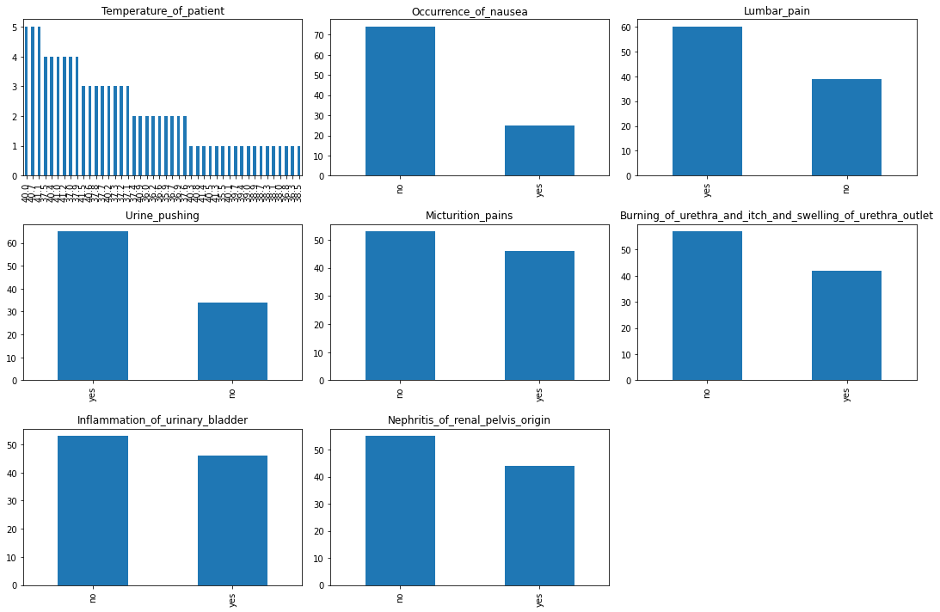
Here it becomes clear to us that the weakest disease symptom in determining the type of disease is Occurrence Of Nausea, as a large percentage did not feels nauseous. A large number of people recorded that they suffer from Lumbar pain and urine pushing, so these two symptoms seem to be a hand in determining the disease.
Frequency for each column

Slide 3
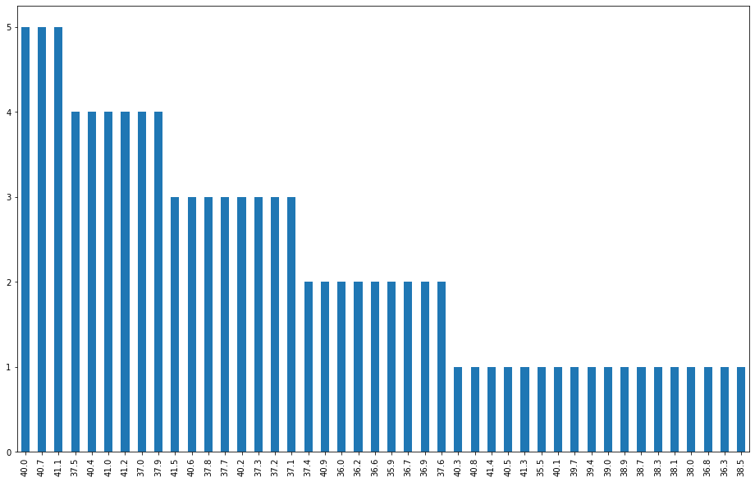
Temperature bar chart Frequency table
Most common temperatures are (40.0,40.7,41.1)
least common temperatures are (40.3,40.8,41.4,40.5,41.3,35.5,40.1,39.7,39.4,39.0,38.9,38.7,38.3,38.1,38.0,36.8,36.3,38.5)
Aggregation :-
We have 6 symptoms of diseases. We want to represent each symptom with Inflammation_of_urinary_bladder and Nephritis_of_renal_pelvis_origin so that we can study the relationships and see the effect of each symptom on a disease.
Combination : A bar charts showing the correlation between two columns in general "but I prefer do it in a pivot way The best study offer“.

Slide 4
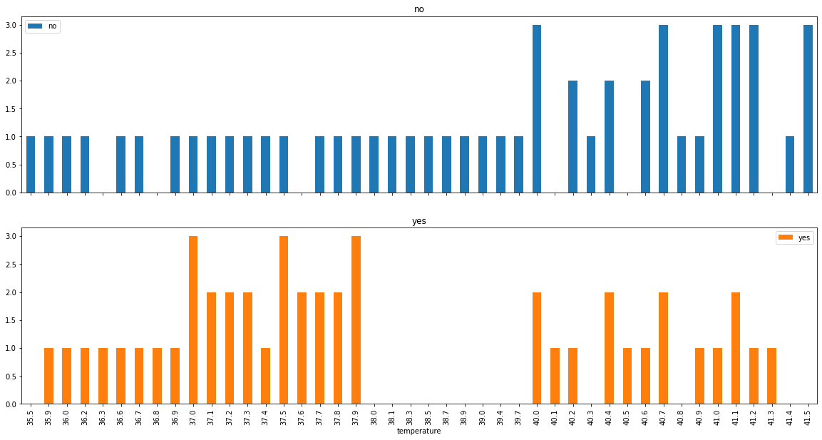
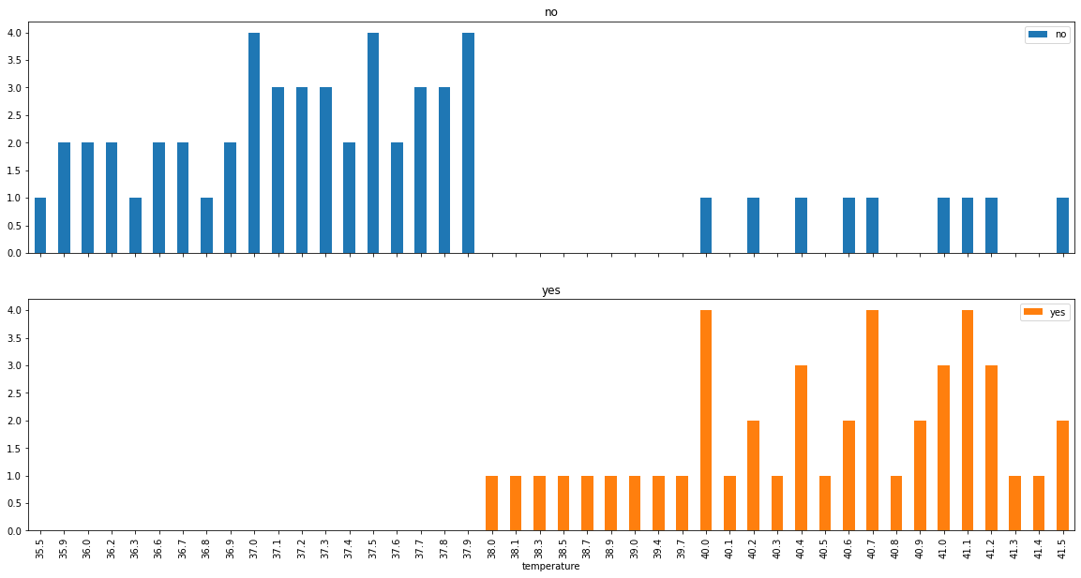
Temperature_of_patient Relations
1- Relation between Temperature_of_patient and Inflammation_of_urinary_bladder
2- Relation between Temperature_of_patient and Nephritis_of_renal_pelvis_origin
Temperature ratios of 38 or less for the Inflammation_of_urinary_bladder. Temperature ratios of 38 or more for the Nephritis_of_renal_pelvis_origin.

Slide 5
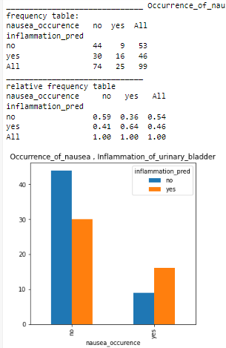
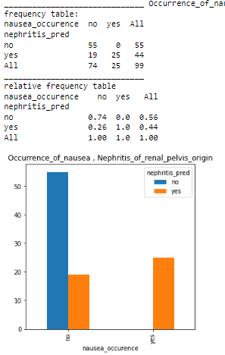
Occurrence_of_nausea
Weakest disease symptom in determining the type of disease is Occurrence Of Nausea, as a large percentage did not feels nauseous.

Slide 6
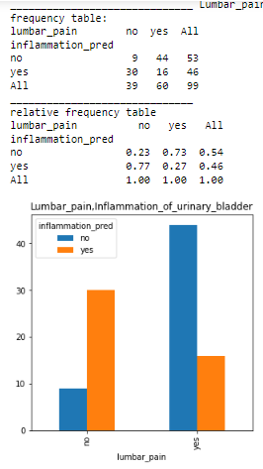
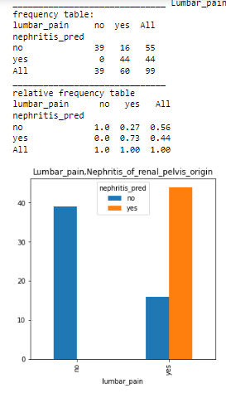
Lumbar_pain
Lumbar_pain affects in a weak way Inflammation_of_urinary_bladder.On the other hand, however, it affects greatly Nephritis_of_renal_pelvis_origin.

Slide 7
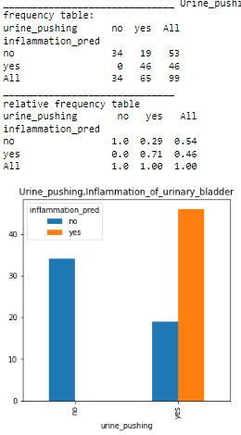
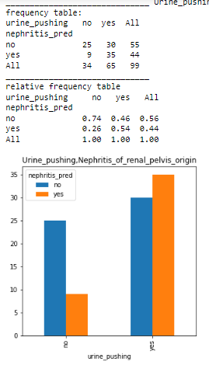
Urine_pushing
Urine_pushing it most common for Inflammation_of_urinary_bladder and least common for Nephritis_of_renal_pelvis_origin

Slide 8
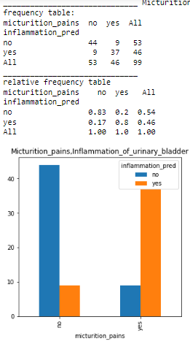
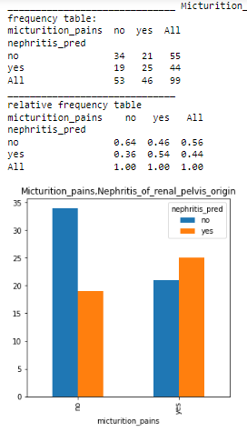
Micturition_pains
Micturition_pains it most common for Inflammation_of_urinary_bladder and least common for Nephritis_of_renal_pelvis_origin

Slide 9
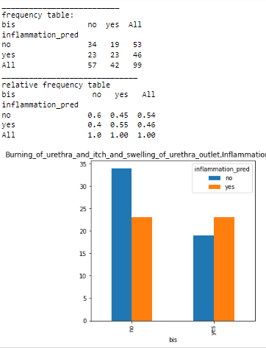
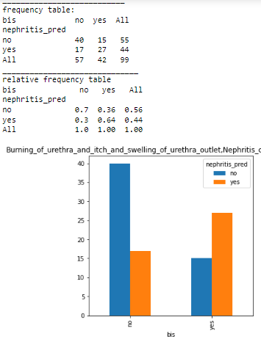
Burning of urethra and itch and swelling of urethra outlet
Has an effect but not strong

Slide 10
The project was presented to a general practitioner, who noted that all of the results shown make a lot of sense. He added that it is advisable to take more data from patients in order for the disease prediction process to succeed correctly. Accordingly, it was agreed to add more proposals to the project, as follows:-
1- It is true that lower back pain is very common in nephritis, but on the other hand, lower abdominal pain is very common in cystitis.
2- Determining the sex, it is recognized in the medical field that females are more susceptible to cystitis.
3- Perform a urine test to see the level of white blood cells in the blood, and the presence of bacteria in the urine.
4- Signs of blood poisoning (featured in nephritis).
5- Low blood pressure (featured in nephritis).
6- Rapid heartbeat (contained in nephritis).

